Slide 1
List Comprehensions – Basics
Task: Store the Squares of the first ten Natural Numbers in a List
The Traditional Way:
# Define an empty list called squares, to hold our square numbers
squares = [ ]
# Go over the first ten numbers, square them, and append them # to the list
for number in range(1, 11):
new_square = number ** 2
squares.append (new_square)

Slide 2
List Comprehensions – Basics
Task: Store the Squares of the first ten Natural Numbers in a List
Traditional Way – but a little more compact:
# Define an empty list called squares, to hold our square numbers
squares = [ ]
# Go over the first ten numbers, square them, and append them # to the list
for number in range(1, 11):
squares.append (number ** 2)

Slide 3
List Comprehensions – Basics
Task: Store the Squares of the first ten Natural Numbers in a List
Non-Traditional Way – List Comprehension:
# Carry out all the Operations within the List itself
squares = [number **2 for number in range (1, 11) ]
# A second case : List of first hundred even numbers
evens = [number *2 for number in range (1, 101) ]
# A third case : Initialization of a matrix of known size
mat = [[0.0] * num_columns for i in range (num_rows) ]

Slide 4
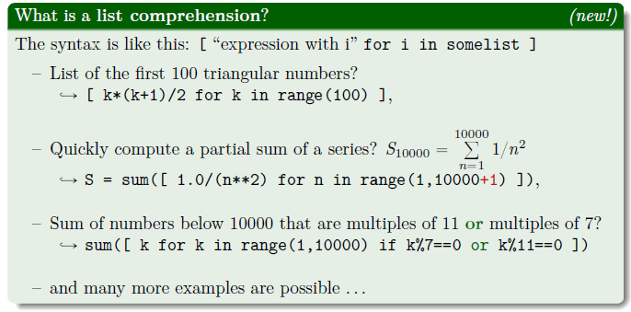
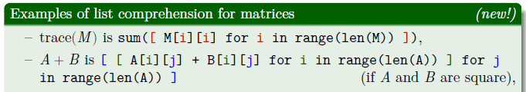

Slide 5
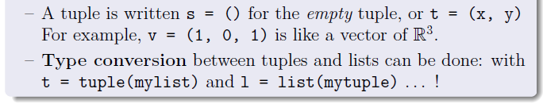
Tuples
A Tuple is an immutable list, identified by parentheses instead of
square brackets.
A string is almost like a list of characters:
name = 'batman' is like ['b', 'a', 't', 'm', 'a', 'n']:
– Accessing and slicing is done the same way for strings:
name[0] is 'b', name[3:] is 'man' etc,
– Looping over a string will loop letter by letter ('b','a' etc).
-- Importantly, a string is immutable, so effectively a string can be
considered as a Tuple.

Slide 6
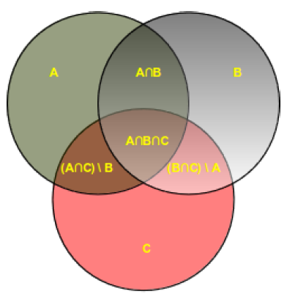
Sets
The Set Data structure is characterized by the following:
Every element is unique – no repeated elements
Elements do not have any specific order
Defined by curly brackets { }, so fruits = {‘apple’, ‘orange’, ‘pear’} is a set
Have functional representation for almost all operations in Set Theory

Slide 7
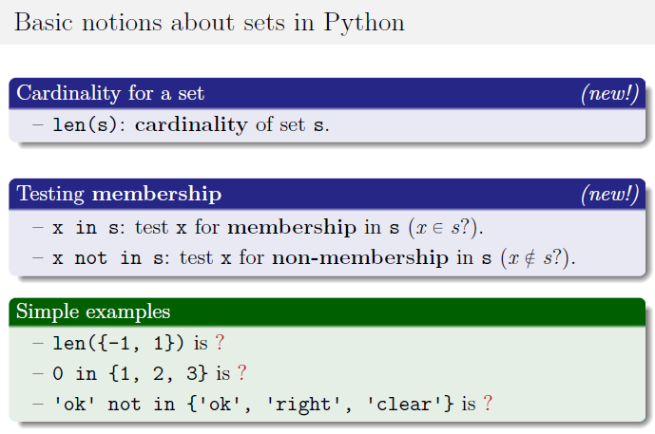

Slide 8
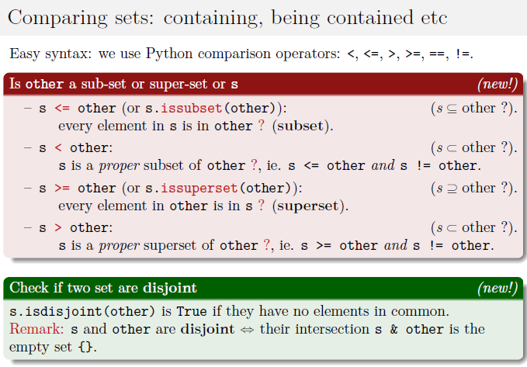

Slide 9
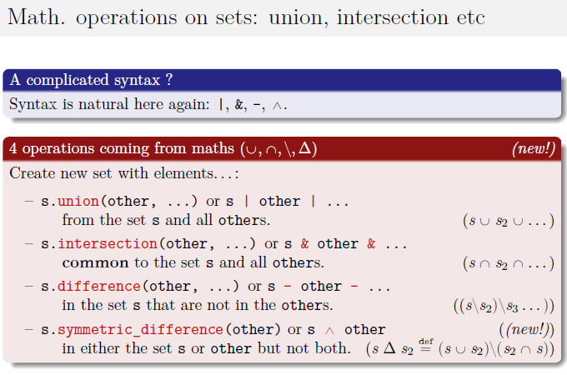

Slide 10
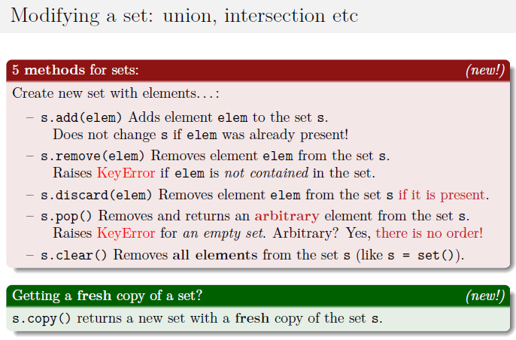

Slide 11
